Slide 1

Future Up - C++ session
Workshop 1/3

Slide 2
General Schedule
26 March 5:30 – Bazel. Google Tests. Can you make this test suite run?
2 April 5:30 – Google Tests: Expects
4 April 5:30 – Google Tests: Fixtures, Setup and Teardown

Slide 3

A few words about me
My name is Carina Camara and I will be you facilitator in learning Google Test Framework ☺
Jobs:
Previously I was a Junior SW Architect at Marelli
And currently I am working as a SW Function Developer in ADAS Department at ARRK R&D (since 15.11.2021)
Studies:
Bachelors Technical University of Cluj-Napoca Computer Science
Masters UBB Business Administration
Contact:
cpp_future_up@arrk-engineering.com

Slide 4
A Few words about arrk R&D
ARRK Engineering | ARRK Engineering (https://engineering.arrk.com)
Our values:
“The five key elements in the performance commitment of ARRK Engineering are:
WE = all employees of ARRK Engineering.
CERTAINTY = through distinct competence and experience for many years.
GOOD FEELING = personal contact ("we like working together").
ALWAYS = with every project, with every problem solution, with every task.
IN THE BEST HANDS = understand customer needs 100 % and implement them.”
Automated Driving | ARRK Engineering (https://engineering.arrk.com/competences/automated-driving)
Current job offers | ARRK Engineering (https://engineering.arrk.com/jobs-career/current-job-offers)

Slide 5
Workshop 1/3
Schedule for today:
1. Case Studies
2. What is Software Testing?
3. 7 Principles of Software Testing
4. Google Test & Bazel
4.1 Optional: Bazel in action
4.2 Google Test framework in action
5. Bibliography
6. Quiz time

Slide 6
Case Studies
Starbucks was forced to close about 60% of stores in U.S and Canada due to software failure in its POS system. At one point, stores served free coffee as they were unable to process the transaction.
Slack software recently flawed into a feature that allowed sending DMs without the other user accepting the request. In simple words, it allowed anyone to slip into your DMs without even your permission. This made users of slack complain since the app offered no option to turn off such texts and causing unwanted messages to slip into the inbox.
It is one of the recent software failures confirmed by Yahoo itself on September 22, 2016. Yahoo claimed that a copy of specific user account information was stolen from the organization’s network.
Tesla will recall a maximum of 135,000 cars to fix computer memory issues in the touchscreen that could cause a loss of some features notified by the electric car manufacturer to the U.S NHTSA (National Highway Traffic Safety Administration).

Slide 7

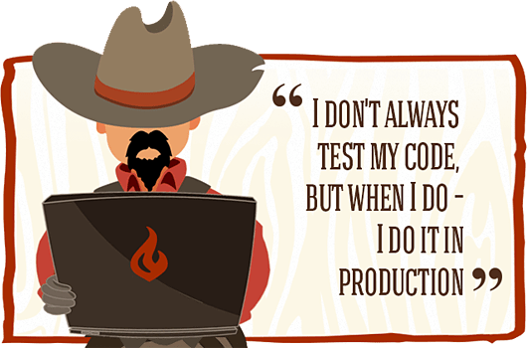

Slide 8
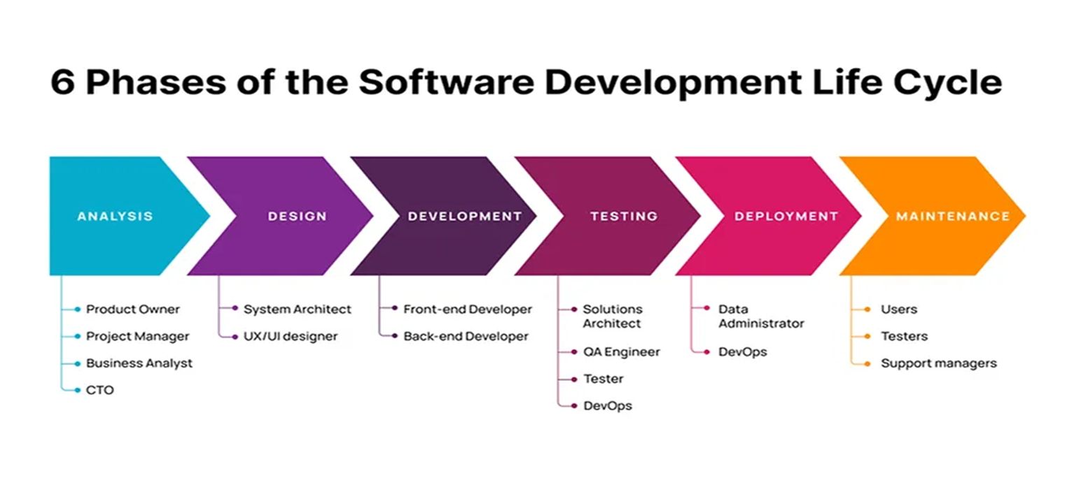
What is Software Testing?
Software testing = activity to check whether the actual results match the expected results
and to ensure that the software system is Defect free.
It involves execution of a software component or system component to evaluate one or more properties of interest.
Scope -> identify errors, gaps or missing requirements in contrary to the actual requirements. It can be done manually or using automated tools.

Slide 9
Types of Software Testing
Testing Category | Types of Testing
Functional Testing | Unit Testing Integration Testing Smoke (Confidence Testing) UAT (User Acceptance Testing) Localization Globalization Interoperability Etc
Non-Functional Testing | Performance Endurance Load Volume Scalability Usability Etc
Maintenance | Regression Maintenance

Slide 10
From problem to solution
Manual testing vs Automated testing
Tools used in Software Testing
List of unit testing frameworks – Wikipedia (https://en.wikipedia.org/wiki/List_of_unit_testing_frameworks)

Slide 11
7 Principles of Software Testing
Exhaustive testing is not possible
Defect Clustering, approximately 80% of the problems are found in 20% of the modules
Pesticide Paradox, in order to keep testing effective, the test cases need to be regularly reviewed and revised, adding new and different test cases
Testing shows a presence of defect, not the absence of defects
Absence of Error – fallacy (myth), be aware of testing for wrong requirements
Early Testing
Testing is context dependent

Slide 12
Google Test & Bazel
Google Test, often referred to as gtest, is a specialized library utilized for the purpose of conducting unit testing within the context of the C++ programming language.
GitHub - google/googletest: GoogleTest - Google Testing and Mocking Framework
Bazel is an open-source build and test tool similar to Make, Maven, and Gradle. It uses a human-readable, high-level build language. Bazel supports projects in multiple languages and builds outputs for multiple platforms. Bazel supports large codebases across multiple repositories, and large numbers of users.
GitHub - bazelbuild/bazel: a fast, scalable, multi-language and extensible build system

Slide 13
Optional: Bazel in action
Let’s define the following structure:
my_project
main
BUILD
hello_world.cc
hello_greet.cc
hello_greet.h
WORKSPACE
tells Bazel how to build different parts of the project. A directory within the workspace that contains a BUILD file is a package. Contains at least 1 rule (target), as a set of instructions and points to specific files (.cc, .h).
identifies the directory and its contents as a Bazel workspace and lives at the root of the project's directory structure.

Slide 14
Optional: Bazel in action
Let’s define the following structure:
my_project
main
BUILD
hello_world.cc
hello_greet.cc
hello_greet.h
WORKSPACE
cc_library(
name = "hello_greet",
srcs = ["hello_greet.cc"],
hdrs = ["hello_greet.h"],
)
cc_binary(
name = "hello_world",
srcs = ["hello_world.cc"],
deps = [
":hello_greet",
],
)
Details: https://bazel.build/start/cpp#stage_2_multiple_build_targets

Slide 15
Google Test framework in action
Open Visual Studio Community (or your preferred IDE)
Understand the system, understand the test specifications
Let’s write some code (get access to codeshare.io)
Open/Create the test file and write tests
Unit Tests (validating that each software unit performs as expected. A unit is the smallest testable component of an application)
Integration Tests (ensuring that software components or functions operate together)
User Acceptance Tests (subset of the suite of tests performed at the system test level)
Regression Tests (checking whether new features break or degrade functionality)

Slide 16
High Level View
Google Test (Test suits)
uses
Main (Driver code)
Headers (library)
uses

Slide 17
Trouble Shooting

Slide 18
Solution Requirements
Functional System Requirements
1. The System shall display lights status and activate lights, based on illumination and proximity sensors and driver button.
Functional Software Requirements
The Software shall read inputs such as:
button states
illumination sensor
proximity sensor
The Software shall compute a light status based on input as following:
If button is off, lights and display shall be off
If button is “low beam”, lights and display shall be low beam
If button is “high beam”, lights and display shall be high beam
If button is “automatic”, the SW shall check for sensor values as following:
If illumination sensor reads daytime, lights and display shall be off
If illumination sensor reads nighttime and no vehicle approaching, lights and display shall be high beam
If illumination sensor reads nighttime and a vehicle approaching, lights and display shall be low beam
The Software shall send the status to display and lights.

Slide 19
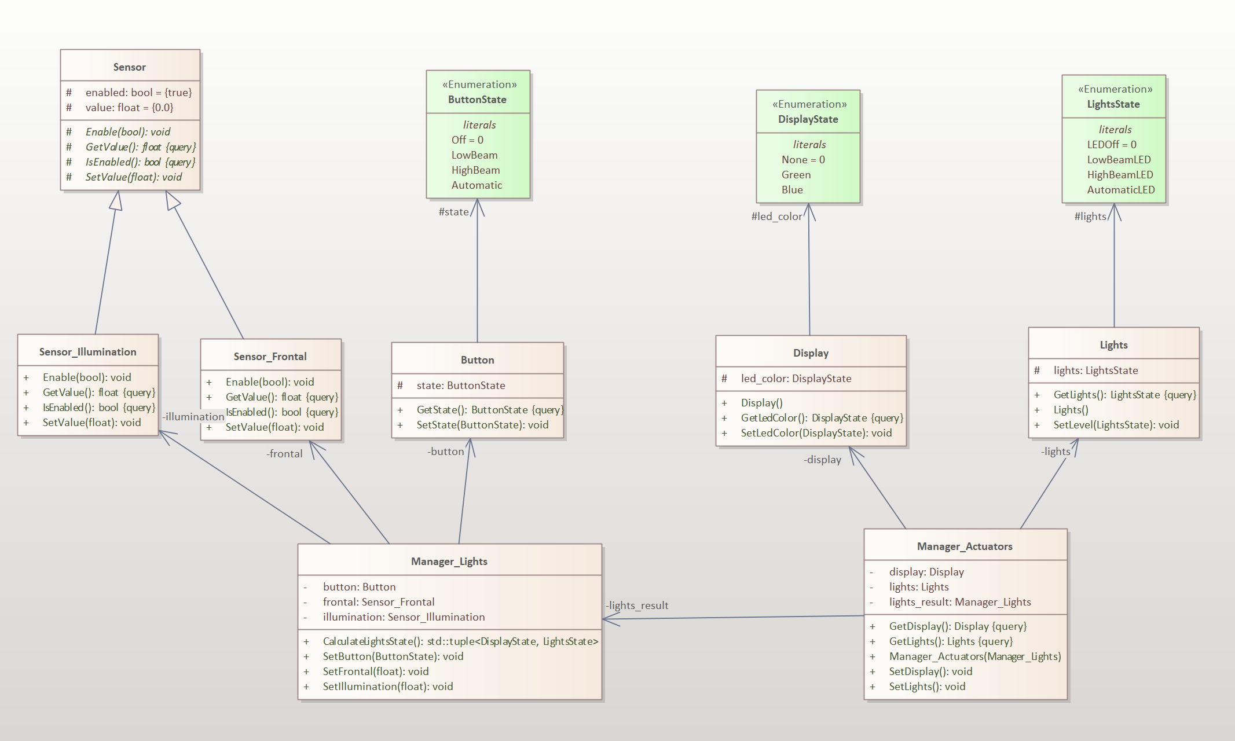
Class Level View (Structural view)

Slide 20
Google Test framework in action
Unit Tests - Test design specification:
#1UB.SwV1.0 Unit Test Button SwC / 26.03.2024 / 1.0 / Future Up
Covering SwReq #1.1
Setup: none
Description: Given button in a state, expect the same state described in SW
Pass Criteria: button state is the same
Fail Criteria: button state has a different state

Slide 21
Google Test framework in action
Unit Tests - Test design specification:
#1UML.SwV1.0 Unit Test Manager_Lights SwC / 26.03.2024 / 1.0 / Future Up
Covering SwReq #2.1 – 2.4
Setup: Given button in X state, illumination and proximity sensor set to Y and Z
Description: Compute lights signal state based on inputs
Pass Criteria: signal is the same as stated in requirements
Fail Criteria: signal has a different state

Slide 22
Google Test framework in action
Integration Tests - Test design specification:
#1UML.SwV1.0 Integration Automatic function / 26.03.2024 / 1.0 / Future Up
Covering: SysReq #1
Setup: At least one instance of Manager_Lights and Manager_Actuators needed
Description: Turn expected lights based on illumination and proximity sensor when button is on automatic
Pass Criteria: As described
Fail Criteria: Any other light than described one

Slide 23
Google Test framework in action
User Acceptance Tests - Test design specification:
#1UML.SwV1.0 UAT Button function / 26.03.2024 / 1.0 / Future Up
Covering SwReq #2.1 – 2.4
Setup: At least one instance of Manager_Lights and Manager_Actuators needed
Description: Turn expected lights based on user’s button
Pass Criteria: As described
Fail Criteria: Any other light than described one

Slide 24
Google Test framework in action
Regression Test - Test design specification:
#1UML.SwV1.0 Regression rear lights / 26.03.2024 / 1.0 / Future Up
Covering SysReq #2
Setup: New lights, new break pedal
Description: Turn expected lights based on user’s button
Pass Criteria: Fog light low beam / high beam / off based on user button
Fail Criteria: Any other light than described one

Slide 25
bibliography
Top Software Failures Due to Lack of Testing (bugraptors.com)
Google Test – Wikipedia
Intro to Bazel
A Deep Dive into SDLC: From Planning to Deployment | Product Coalition
Learn Software Testing in 24 Hours - Google Books
What is Software Testing and How Does it Work? | IBM

Slide 26
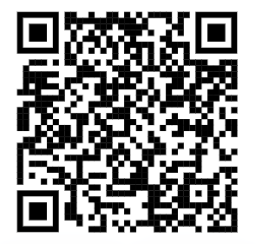
Quiz time
https://forms.gle/A9662B27hKY26weV8

